Slide 1
Realworld -Toptal 2023
Florian Proksch
See Notes on last slide

Slide 2
Contents
Architecture ( with Diagram)
Folder Structure
Scaling Considerations
Logs
Backup
How to add an Endpoint?
How to add a Stage?
Notes
Demo Links

Slide 3
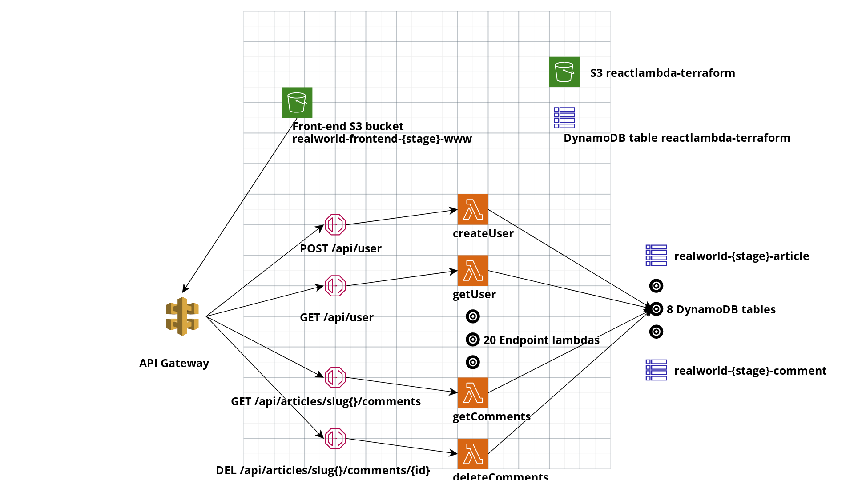
Architecture

Slide 4
Architecture
3-Tier architecture
Front-end is react deployed to S3 via github actions
Back-end is 20 lambdas in Go deployed via github actions
API Gateway with 20 endpoints are connected to the lambdas
The lamdas access DynamoDB (DB tier) tables for data storage
Architecture is provisioned via Terraform
Statefile lives in S3
Lockfile in DynamoDB
Github Actions monitor for changes and update infrastructure on push
Actions are per Stage
In this Demo “Staging” is implemented as example Stage
See later Slide for how to add new Stages

Slide 5
Folder Structure (1 of 2)
Mono Repo with all 3 tiers
/backend-go
/Bin (executables deployed as ZIP to lambdas, 1 lambda for each)
/frontend
/Build (React publish)
/Src (Source code)
/terraform
/Init (tf file to initialize IAM, and backend)
/Modules
/Staging (example stage)

Slide 6
Folder Structure (2 of 2)
Detailed view of Terraform folder from last slide:
/Init (tf file to initialize IAM, and backend)
/Modules (modules used for deployment)
/db
/services
/backend
/frontend
/Staging (example stage)
/db
/services
/backend
/frontend

Slide 7
Scaling Considerations
The back-end is limited by the lambdas parallel invoke limit
API Gateway standard Quota is 10,000 RPS
The DynamoDB database is set to Write and Read throughput of 1 for cost saving of this demo
On-demand mode recommended for production use

Slide 8
Logs
Lambdas log to Cloudwatch
Log Groups have the naming convention:
/aws/lambda/realworld-{stageName}-{functionName}
Example:
/aws/lambda/realworld-staging-createArticle
API Gateway logs to Cloudwatch
Log Groups have the naming convention
API-Gateway-ExecutionLogs_{GW Stage ID}/{stageName}
Example:
API-Gateway-Execution-Logs_8nbyg6ow0m/staging

Slide 9
Backup
DynamoDB Point-In-Time recovery is activated for all tables with a 35 day retention
Any point in time can be recovered within that time frame via DynamoDB in Console or AWS CLI

Slide 10
How to add an endpoint
Add a Go build executable
Update terraform/modules/db/main.tf module "api_endpoint" function_configs list - Example:
"NewEndpointName": {
"handler": "New-Endpoint-Handler", #(name of the Go executable)
"verb": "POST",
"resource": aws_api_gateway_resource.users_resource #Reference to the parent resource
},

Slide 11
How to add a Stage
Create a branch with the stage name
Create folders for terraform
Copy from /terraform/staging
Replace “staging” in the file stubs with the new stage name
Duplicate Github actions .github/actions
Deploy_frontend_staging.yaml
Deploy_db_staging.yaml
Deploy_backend_go_staging.yaml
Replace “Staging” with your new stage name
Change the S3 bucket name
run: aws s3 sync build/ s3://reactlambda-frontend-NEWSTAGENAME-www --delete
Change the branch name in each file under on:
push:
branches:
- NewStageName

Slide 12
Notes
As time for this task was running out I realized that I forgot to implement the back-end github action to change the front-end settings file in the S3 bucket of the corresponding stage and replace the base URL with that of API Gateway Stage Invoke_URL
Initially I was planning on implementing the realworld Lambda+Dynamo JavaScript back-end However I discovered that the back-end doesn’t adhere to the API specs.Specifically there were missing parameters like 'articlesCount' in GET /articles/ I saw that there is a similar implementation in Go, so I switched over to that one as a back-end and implmemented it under ‘backend-go’, As this is not a real client project I left the original JS backend under ‘backend’ in the repo
After deploying I discovered that this one did seem to adhere to the specs, however the React front-end was getting errors as well: it didn't seem to like that the taglist is returned as null instead of a list However I already spent quite a lot of time on it and as it is not a real client project I decided to leave the react front-end at that. So to demonstrate the working blog I also added an angular front-end that was in the go back-end repo. This front-end doesn't have tests, so it is really only there for demonstration. For a real client I would offer fixing the mismatch in the react front-end.

Slide 13
How to Access the Demo
- react staging: http://reactlambda-frontend-staging-www.s3-website.eu-central-1.amazonaws.com/
- angular (only for demo purposes):
http://react23test.s3-website.eu-central-1.amazonaws.com/#/

